Slide 1

Institute Technology of Cambodia
Subject : Data mining
Lecturers : PHAUK Sokkhey and Sophal CHAN
Name chhoem xsothy

Slide 2
Ouline
ETL and ELT
About HEVO
The Hevo Advantage
HEVO TOOL

Slide 3
ETL and ELT
ELT (Extract, Load, and Transform) and ETL (Extract, Transform, and Load) are processes that businesses use to extract data from multiple Sources and combine them into a single database or data warehouse for analysis.
Extract: This step involves extracting data from a Source, which may be a database like MySQL or MongoDB or any other application like Google Sheets, Google Drive, or Salesforce.
Load: In this step, the data is loaded to the Destination warehouse or database for analytical workloads.
Transform: This step can be used to cleanse, process, and convert the data into a format suitable for loading to the Destination and further analysis.

Slide 4




About HEVO
Founded 2016
HQ San Francisco, CA, US
Data total Funding $13 m
Time since last funding 2 years ago
Key People/Management at Hevo Data
Manish Jethani
CEO & Co-Founder
Sourabh Agarwal
CTO & Co-Founder
Akhil Krishnan
Principal Product Designer

Slide 5
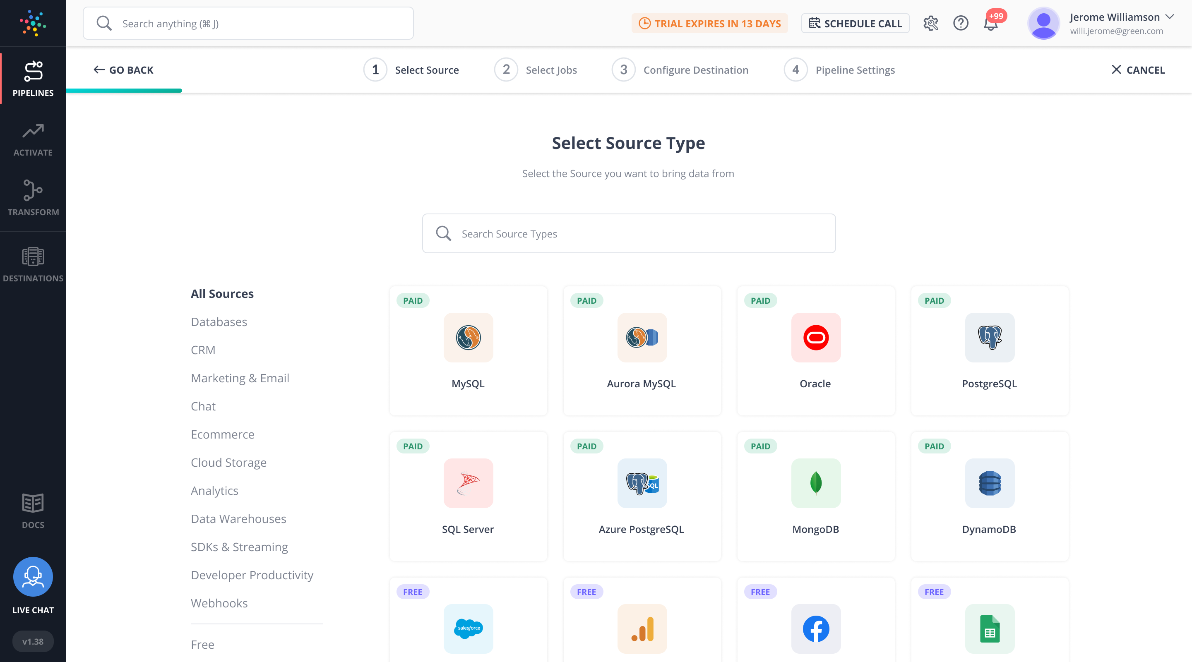
What is HEVO?
Hevo is a no-code, bi-directional data pipeline platform specially built for modern ETL, ELT, and Reverse ETL Needs. It helps data teams streamline and automate org-wide data flows that result in a saving of ~10 hours of engineering time/week and 10x faster reporting, analytics, and decision making.
The platform supports 100+ ready-to-use integrations across Databases, SaaS Applications, Cloud Storage, SDKs, and Streaming Services. Over 500 data-driven companies spread across 35+ countries trust Hevo for their data integration needs.

Slide 6
The Hevo Advantage
The ELT-driven Pipelines in Hevo bring you the following advantages:
Fast loading times: As the Pipelines move the data directly from the Source to the Destination, the loading time is very less.
On-demand Transformations: You can perform On-demand Transformations on the data in the Destination using the data processing power of cloud storage solutions such as Snowflake and Amazon Redshift.
On-demand Transformations: You can perform On-demand Transformations on the data in the Destination using the data processing power of cloud storage solutions such as Snowflake and Amazon Redshift.

Slide 7
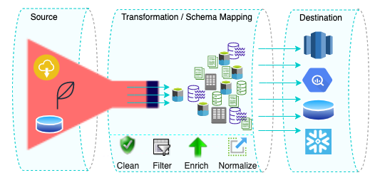
HEVO TOOL
Pipeline: moves your data from a Source system to a Destination database or data warehouse.
Destinations: A Destination is any database or data warehouse to which you want to replicate your data.

Slide 8
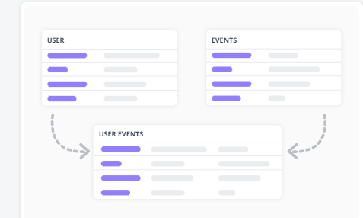
HEVO TOOL (Cont.)
Transform: You can also transform only the data you need for a particular business analysis. The Transform step is achieved using Models and Workflows.
Hevo Activate is a data automation platform that enables you to synchronize raw data residing in your data warehouse with your Target CRM application.

Slide 9
THANK YOU!

